Slide 1
Photometric image formation

Slide 2
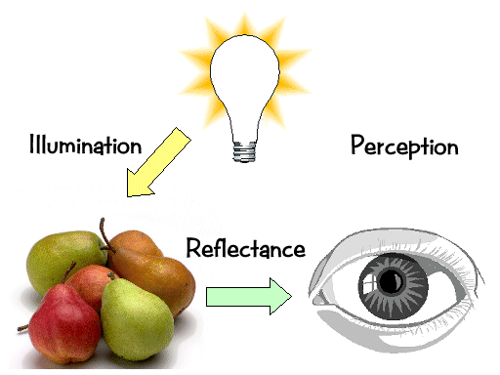
Photometric image formation
The incident light
Position of light source
Direction
Color
The object
Reflectance
Viewer
Position

Slide 3
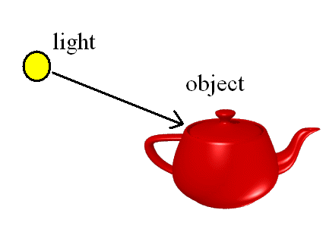
Overview
Illumination (how to calculate the colour)‏
Shading (how to colour the whole surface)?
BRDF (how to simulate the reflection of real objects)‏

Slide 4
Overview
Illumination (how to calculate the colour)‏
Shading (how to colour the whole surface)?
BRDF (how to simulate the reflection of real objects)‏

Slide 5
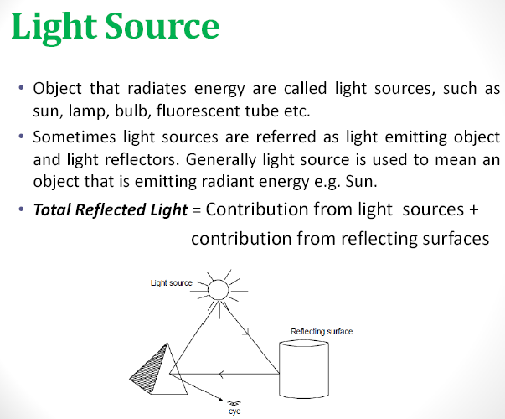

Slide 6
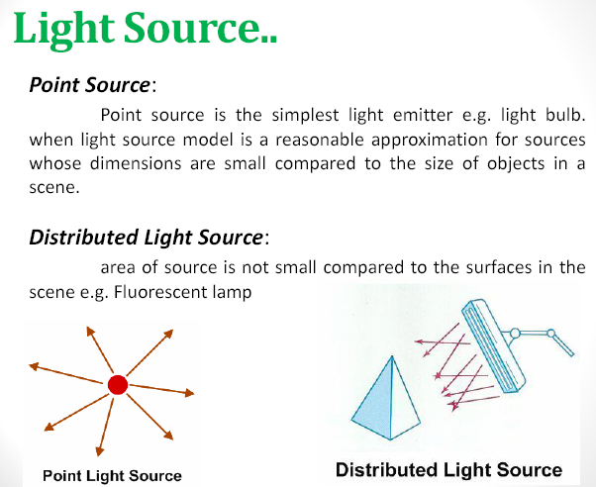

Slide 7
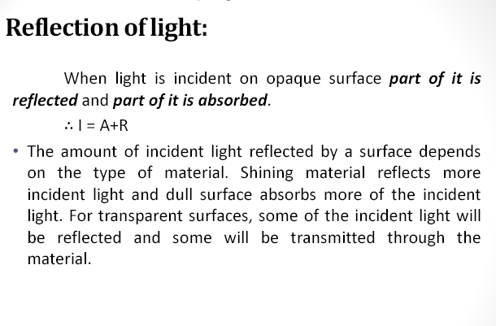

Slide 8
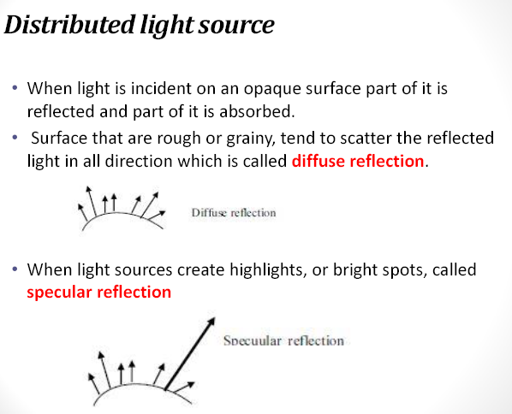

Slide 9
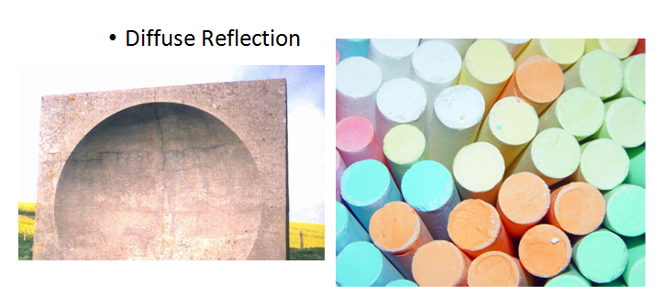
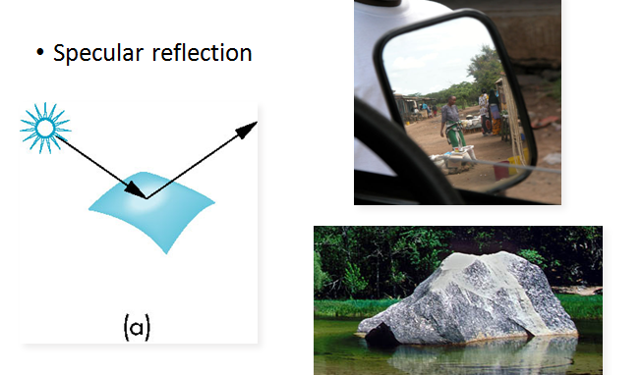

Slide 10
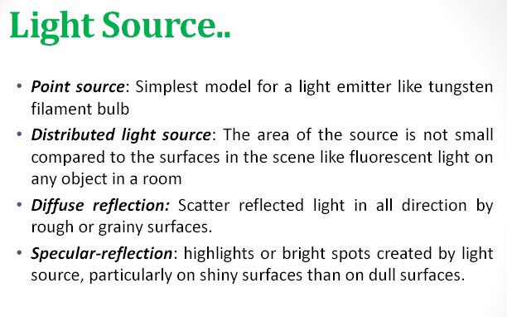

Slide 11
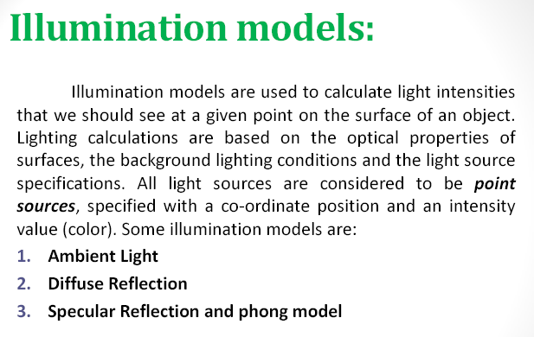

Slide 12
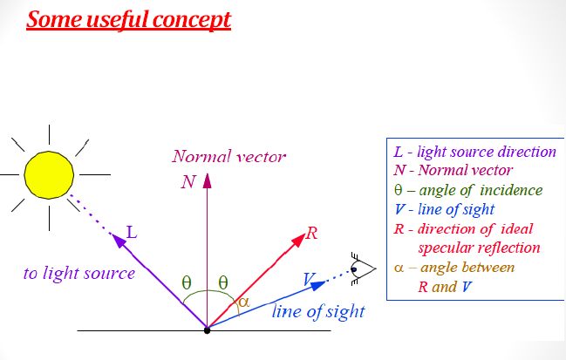

Slide 13
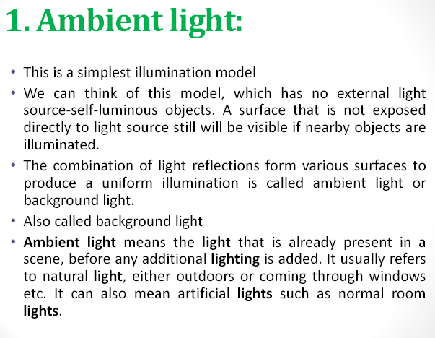

Slide 14
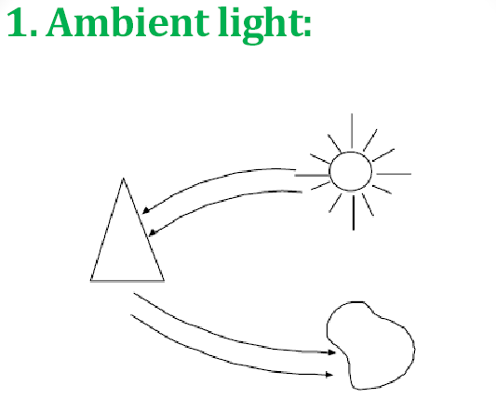

Slide 15
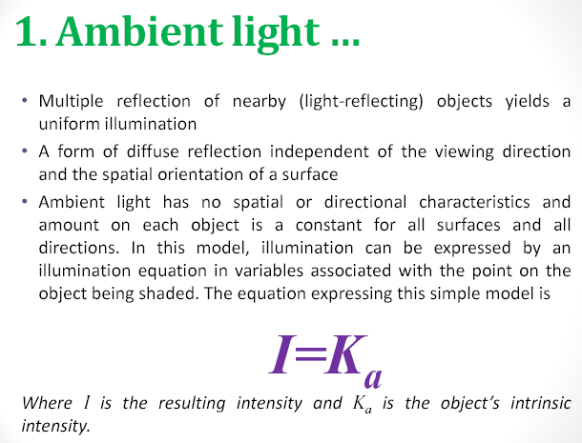

Slide 16
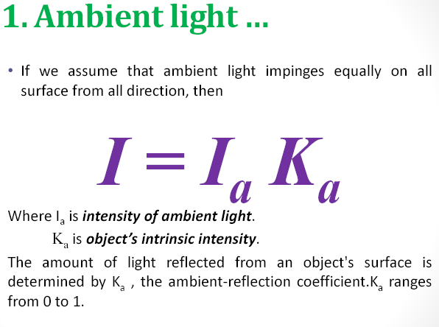

Slide 17
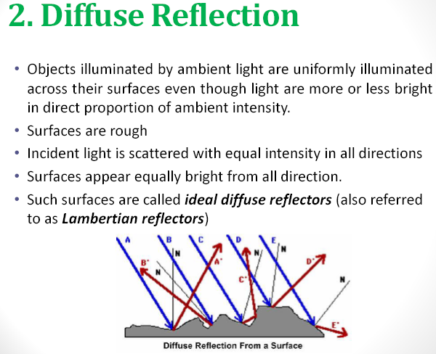

Slide 18
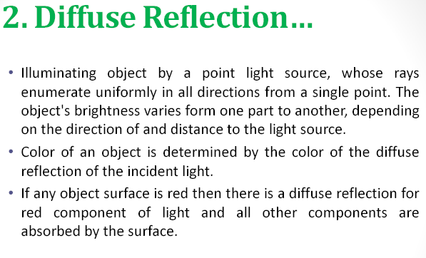

Slide 19
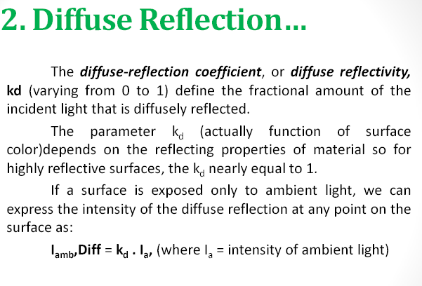

Slide 20
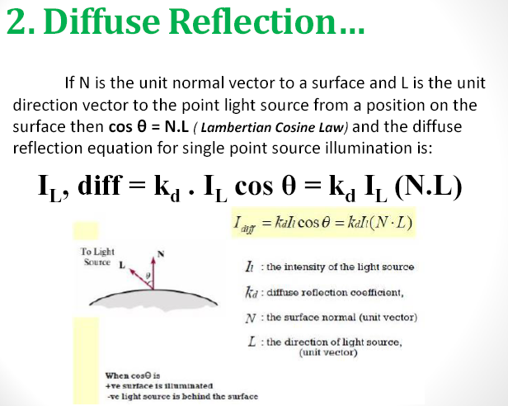

Slide 21
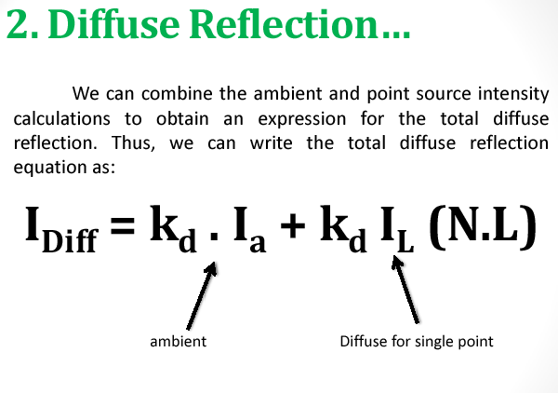

Slide 22
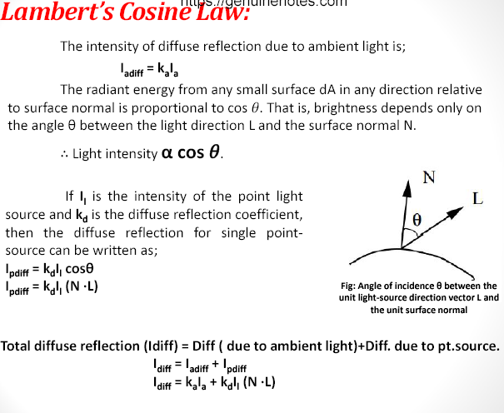

Slide 23
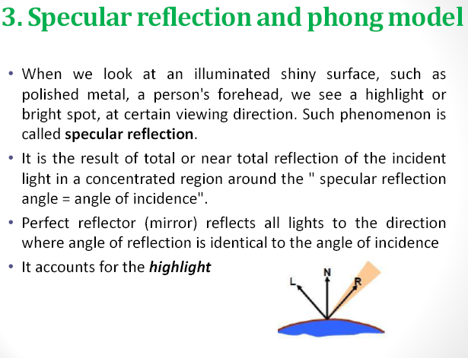

Slide 24
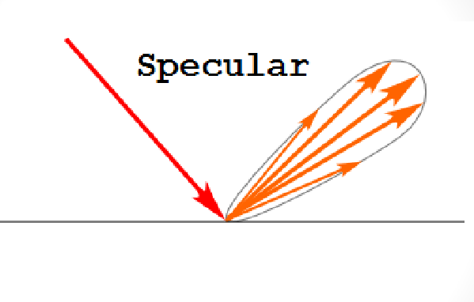

Slide 25
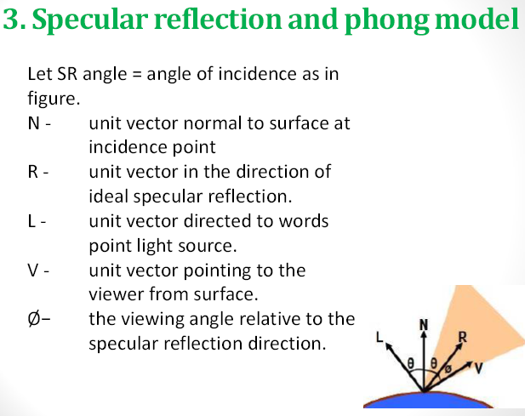

Slide 26
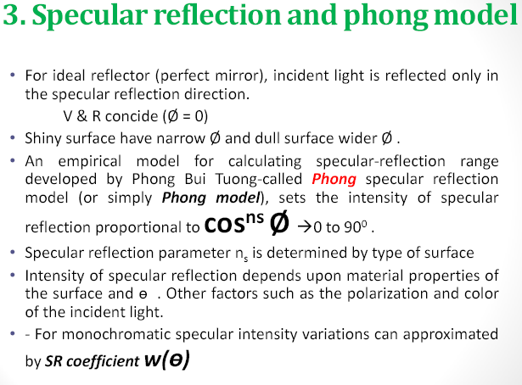

Slide 27
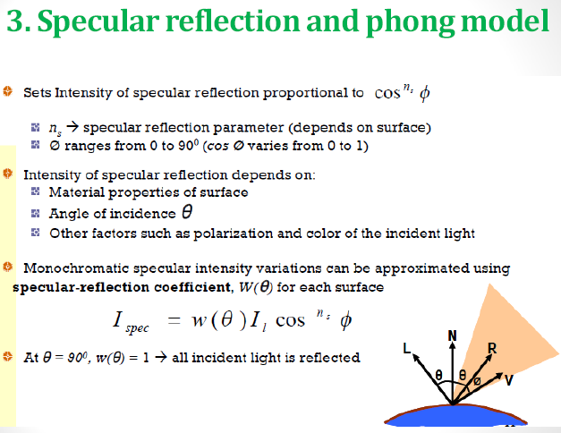

Slide 28
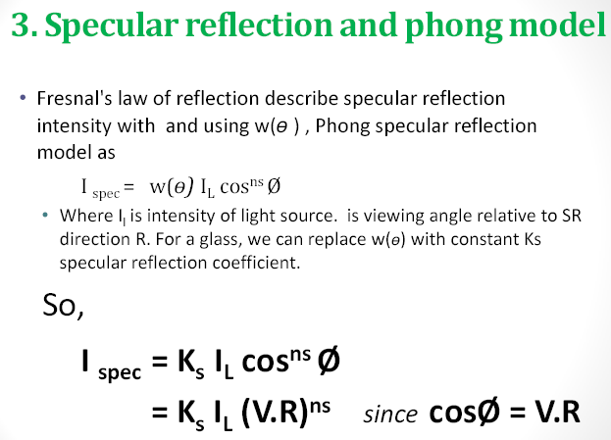

Slide 29
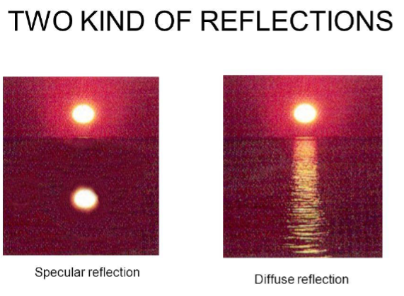

Slide 30
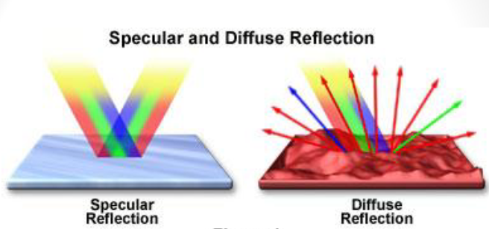

Slide 31
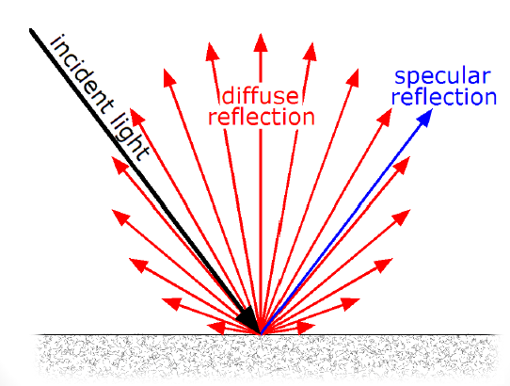

Slide 32
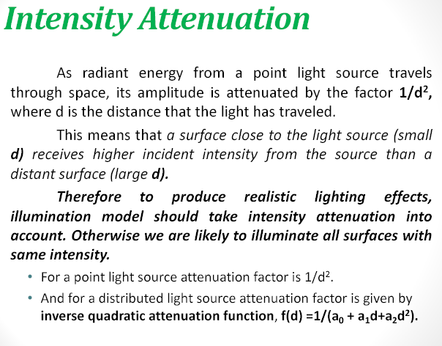

Slide 33
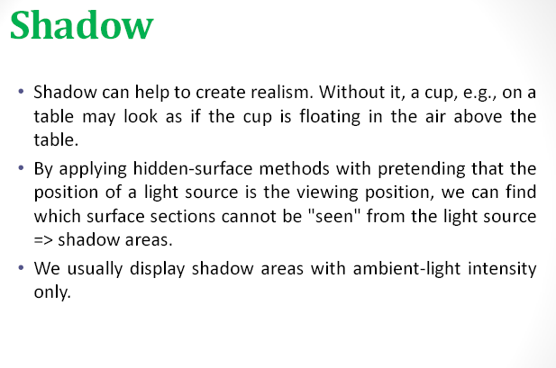

Slide 34
Overview
Illumination (how to calculate the colour)‏
Shading (how to colour the whole surface)?
BRDF (how to simulate the reflection of real objects)‏

Slide 35
SURFACE RENDERING: SHADING
Determine a Color for Each Filled Pixel
How to Choose a Color for Each Filled Pixel
  Each illumination calculation for a ray from the eye point through the view plane provides a radiance sample

Slide 36
Polygon Shading Algorithms
Flat/Constant Shading
Gouraud Shading
Phong Shading

Slide 37
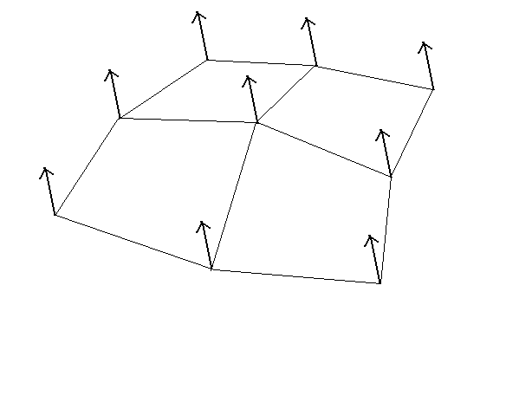
How often do we do the computation of illumination?
At all the points on the surface?
But usually we have normal only at the vertices
Depends on the shading model
– Flat Shading (once per polygon)‏ (less computation needed)
– Gouraud shading (for all the vertices of the polygon)‏
– Phong Shading (all the points)‏(heavy computation needed)‏

Slide 38
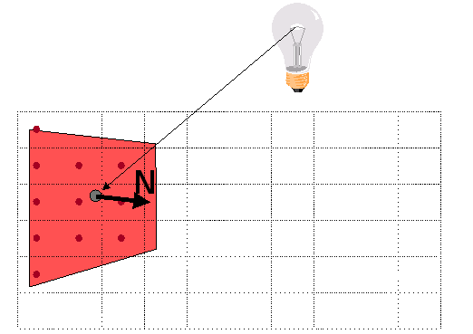
FLAT SHADING
One Illumination Calculation per Polygon
  Assign all pixels inside each polygon the same color

Slide 39
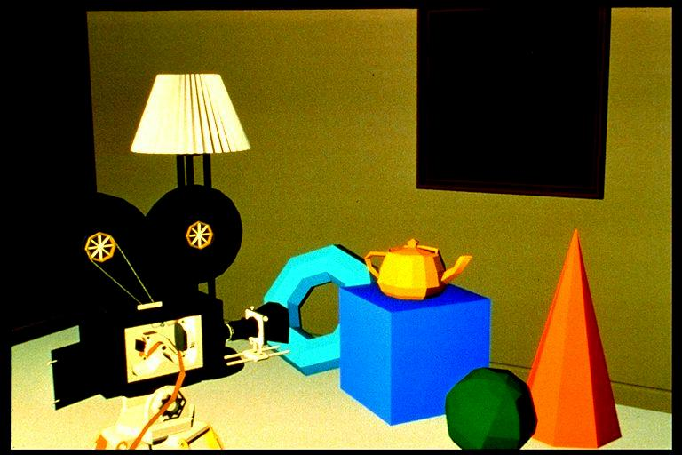
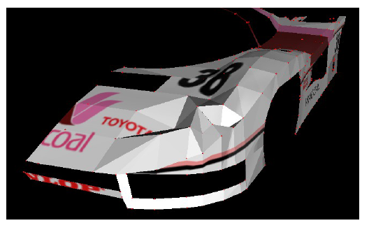
FLAT SHADING
Compute the colour at the middle of the polygon
All points in the same polygon are coloured by the same colour

Slide 40
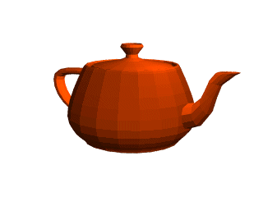
SHADING POLYHEDRON
Flat shading:
  Works well for objects really made of flat faces.
  Appearance depends on number of polygons for curved surface objects.

Slide 41
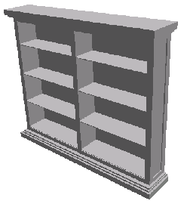
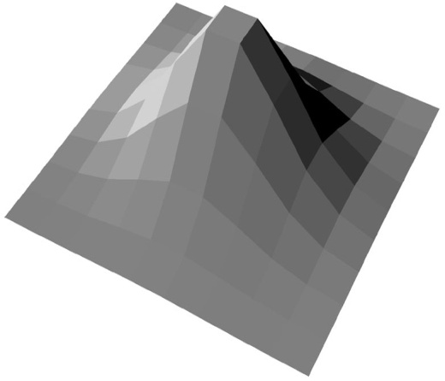
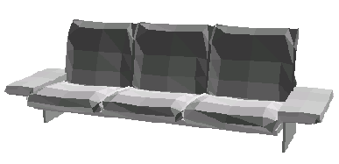
FLAT SHADING
  Objects Look Like They are Composed of Polygons
  OK for polyhedral objects
  Not so good for ones with smooth surfaces

Slide 42

GOURAUD SHADING
  One Lighting Calculation per Vertex
  Assign pixels inside polygon by interpolating colors computed at vertices
N₁
Viewer
V₁
L₁
Light
N₂
N₃
Polygon

Slide 43
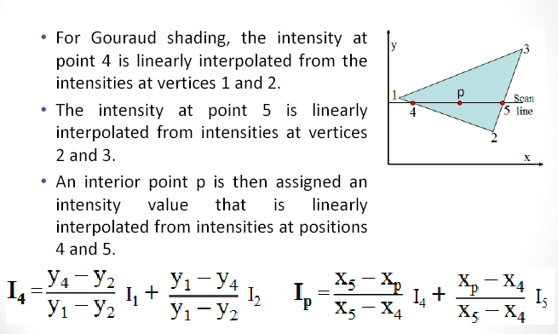
GOURAUD SHADING

Slide 44
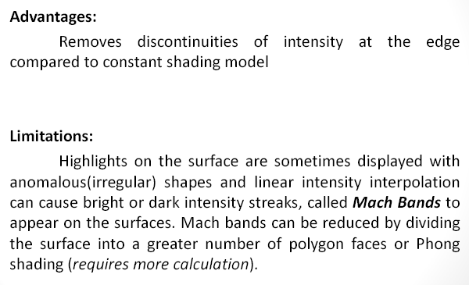
GOURAUD SHADING

Slide 45
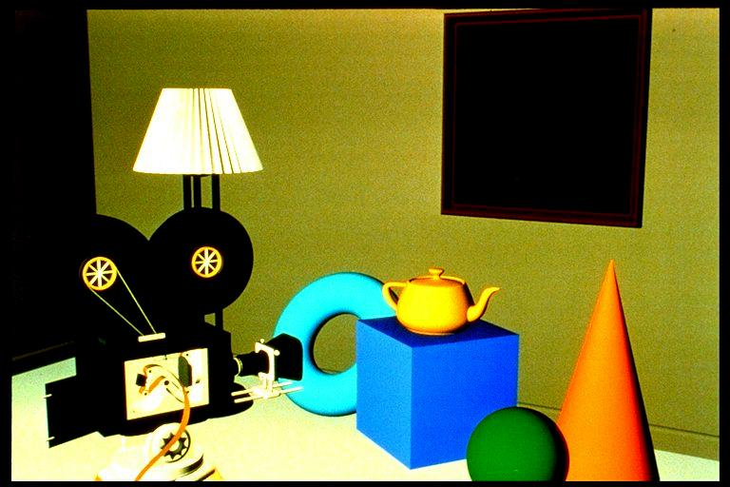
Flat/Constant Shading
Gourand Shading

Slide 46
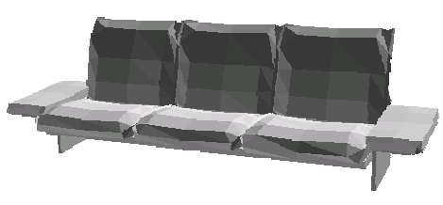
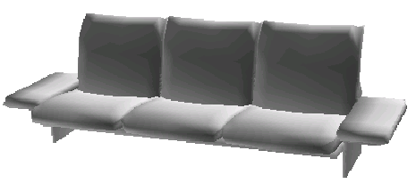
GOURAUD SHADING
  Produces Smoothly Shaded Polygonal Mesh
  Piecewise linear approximation
  Need fine mesh to capture subtle lighting effects
Flat Shading
Gouraud Shading

Slide 47
PHONG SHADING
What if Polygonal Mesh is too Coarse to Capture Illumination Effects in Polygon Interiors?
N₁
Viewer
V₁
L₁
Light
N₂
N₃
Polygon

Slide 48
PHONG SHADING
  One Lighting Calculation per Pixel
  Approximate surface normal for points inside polygons by bilinear interpolation of normals from vertices
N₁
Viewer
Light
N
V
L
N₂
N₃
Polygon

Slide 49
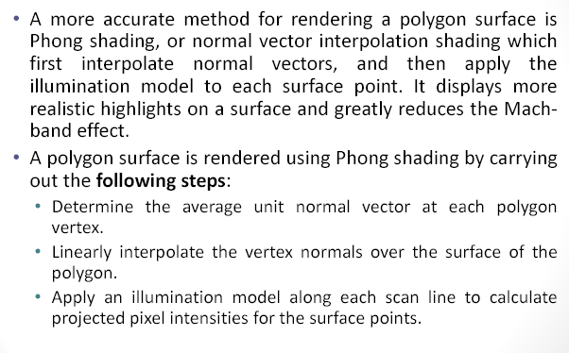
PHONG SHADING

Slide 50
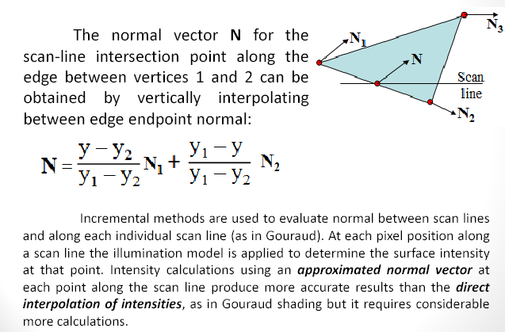
PHONG SHADING

Slide 51
PHONG SHADING
Bilinearly Interpolate Normals at Vertices Down and Across Scan Lines
N₁
α
β
γ
N₂
N₃

Slide 52
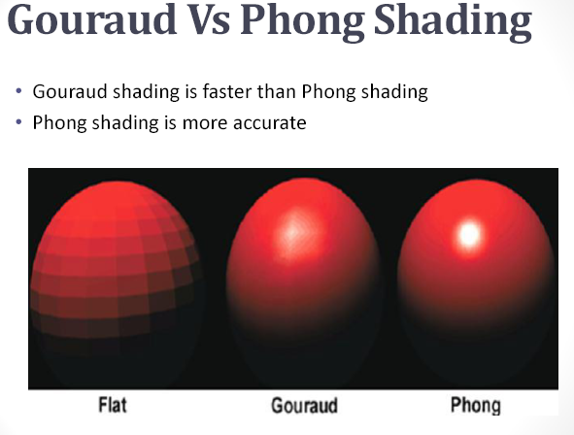

Slide 53
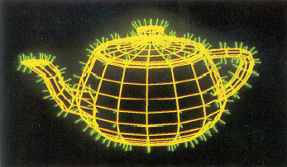
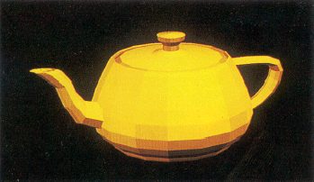


PHONG SHADING
Wireframe
Flat
Gouraud
Phong

Slide 54
THANK YOU

